Slide 1


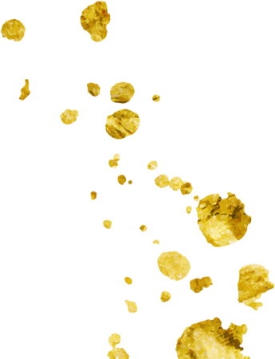
Automated Bank Complaints
Monitoring
sinoF5 Unstructured data

Slide 2
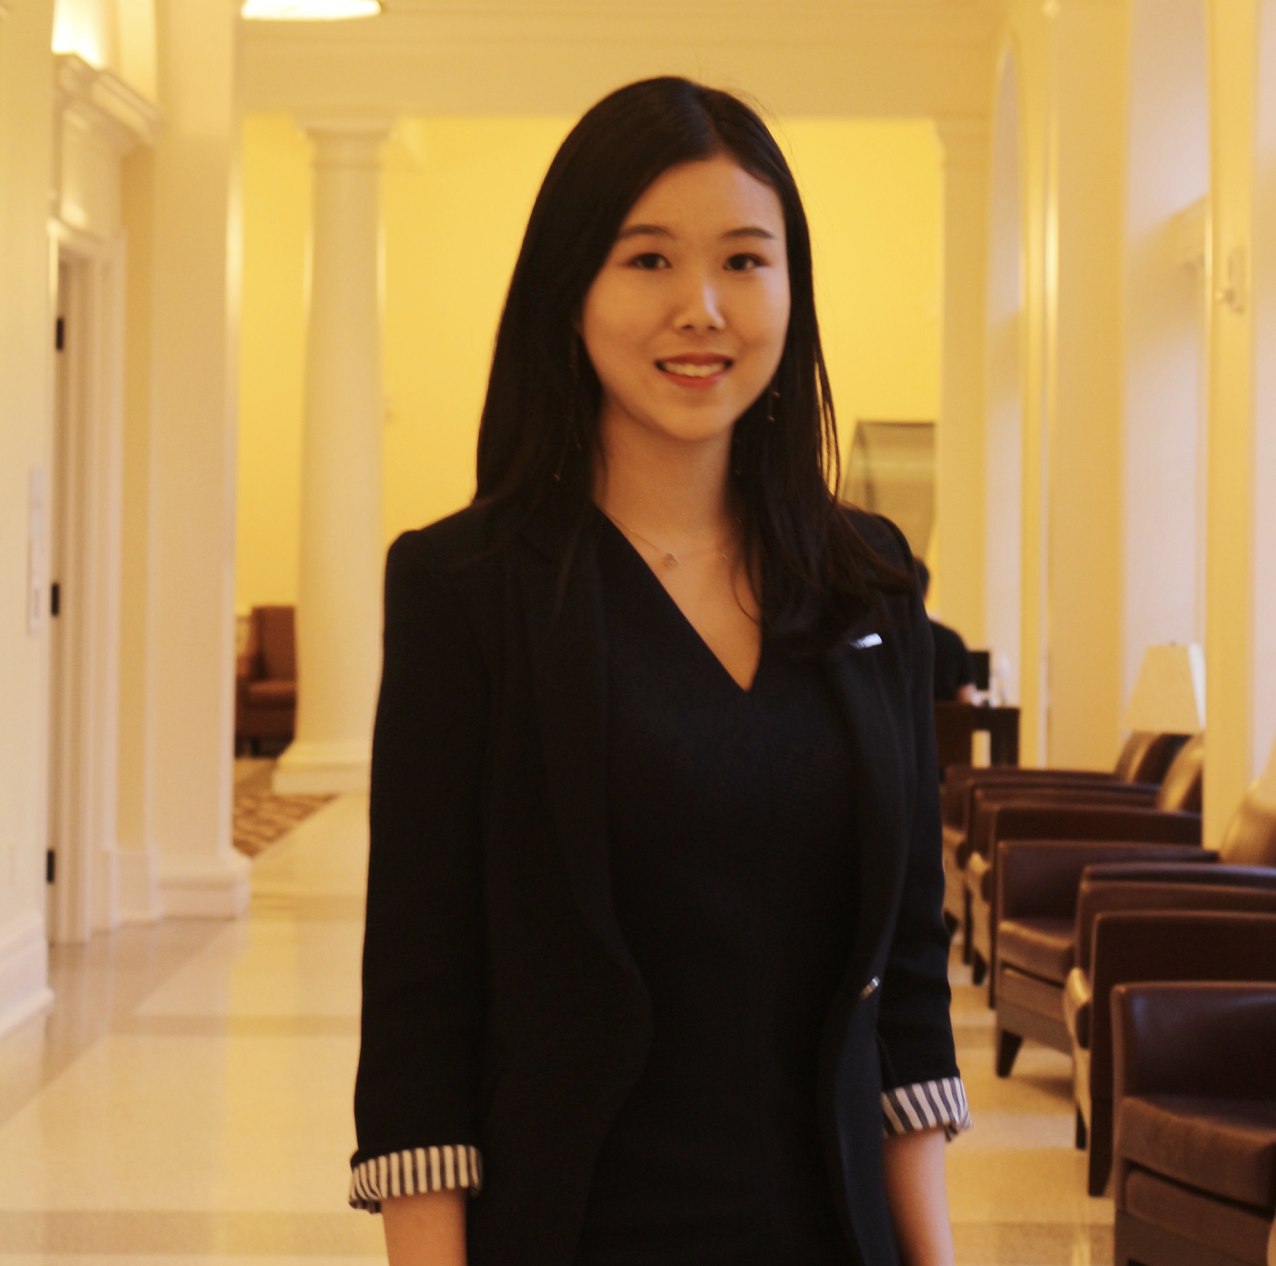

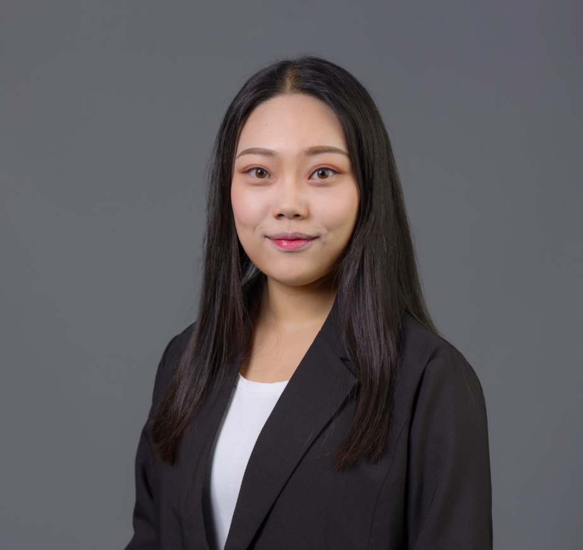
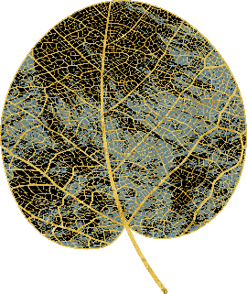
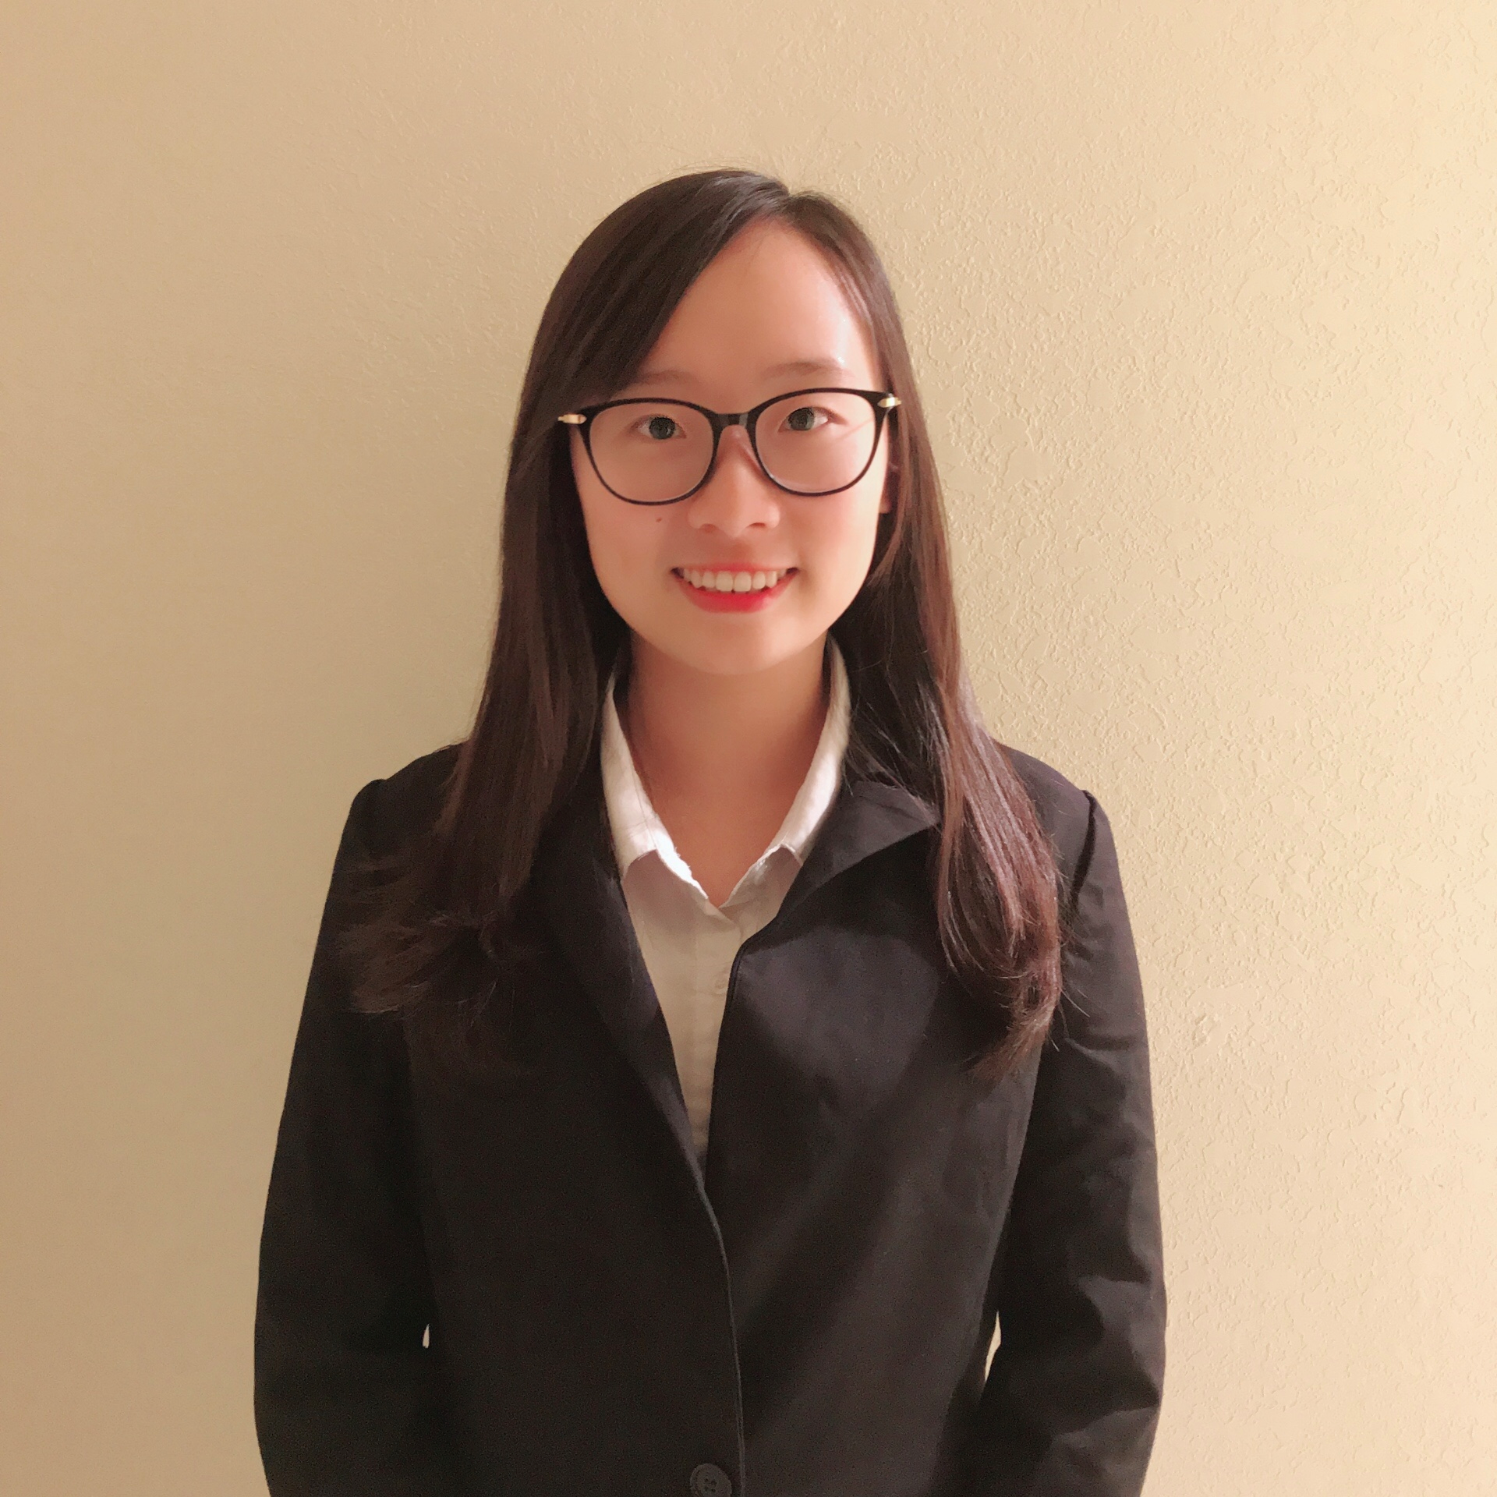

UNITED BANK OF RADY
Customer Service Dep.
Data Science Dep.
2015
Aki Lu
Catherine Liu
Ellen Wu
Letty Hua
Esther Yan

Slide 3


What are customers
complaining about?

Slide 4
Data Description
Total Data | 22984
Monetary Compensated Entries | 5027 (20%)
Non-Monetary Compensated Entries | 17957 (80%)
Notes:
Introduction
major product lines
major subsidiaries

Slide 5
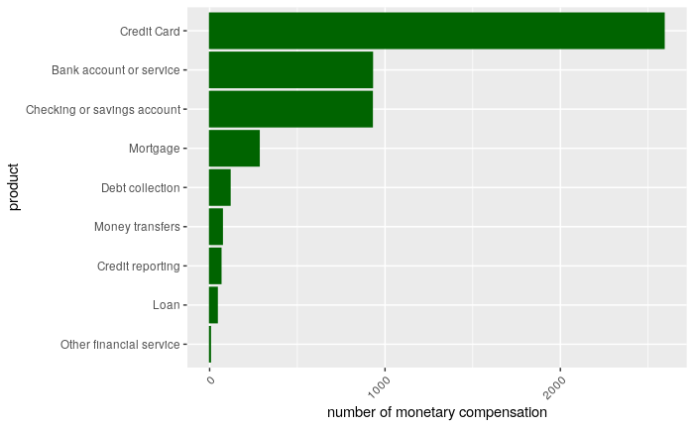
What are the products receiving most monetary compensation?
Most complaints that we give monetary compensation are about
credit card

Slide 6
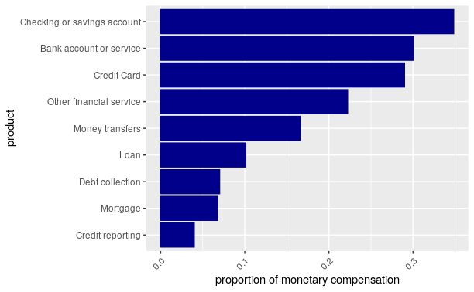
What are the products that have the highest monetary compensation percentage?
checking and bank account
credit card

Slide 7
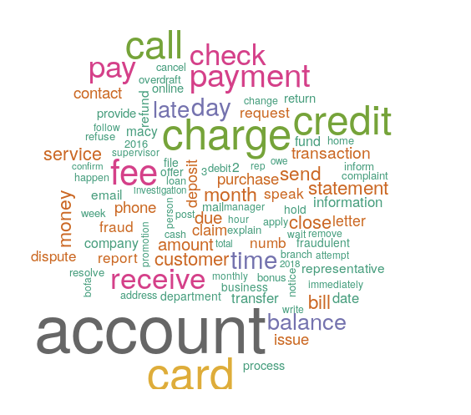
What are the outstanding problems within the complaints that receive monetary compensation?
Notes:
Based on the word clouds, we
Late Fee
Payment
Charge and bill

Slide 8
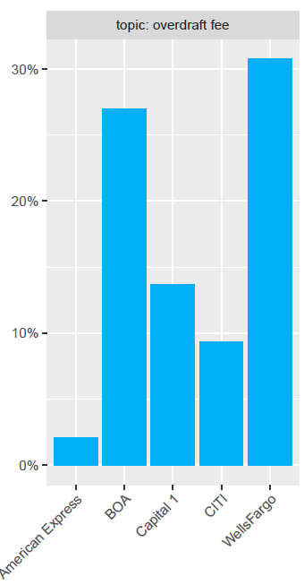
Subsidiary Companies’ problems (Topic Model)
Complaints Topic | Problemetic bank
Credit Card Late Fee | Capital One
Debit Card & Fraud | American Express
Deposit Service Fee & Promotion | CITI
Overdraft Fee | Wells Fargo
Social Security & Credit Deposit | American Express
Notes:
bank account data
EX: WELLS FARGO → NO SPENDING LIMIT

Slide 9
Project Goal
Sort the complaints by the necessity of monetary relief automatically.

Slide 10
Meeting
with Data Science Group
Notes:
I talked with customer service department, firstly, we can put more emphasis on the 3 products: credit card,checking and bank account. I have processed the data.
How long would you take to do the work?

Slide 11
One Week Later

Slide 12
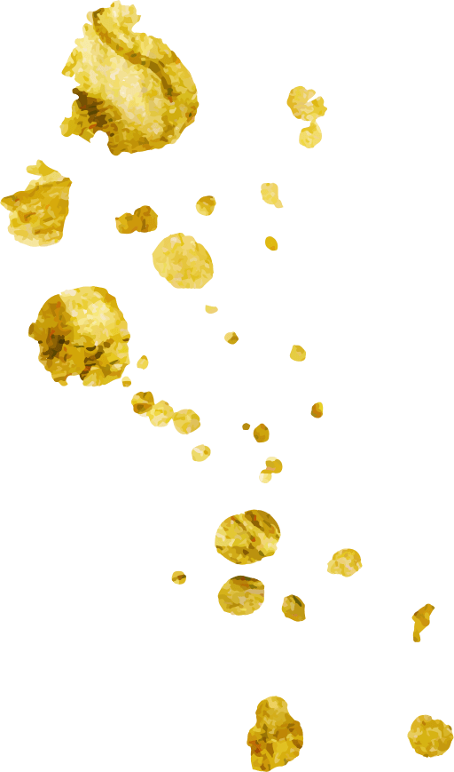


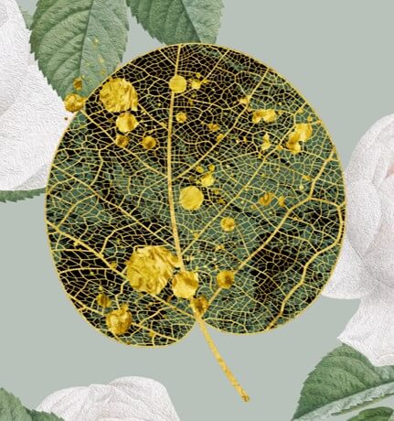
Deep Learning Model with One-hot Encoding
Deep Learning Model with Additional Features
Deep Learning Model with Embeddings

Slide 13

MODEL 1:
Deep Learning Model
with One-hot Encoding
Notes:
这里可以说下试图用TF IDF 来识别1 和0 ，但是筛选下来的词频率非常低。也就是说其实monetary和non monetary的关键词还是比较接近的。

Slide 14
APPROACH
Input variable: One-hot encoded
Output variable: Probability
Metrics: AUC
Unbalanced data (80:20)
Complaints: Original VS cleaned
Top frequent words: 8,000
Notes:
bank account data
EX: WELLS FARGO → NO SPENDING LIMIT

Slide 15
RESULT
Credit Card
Bank Account
# hidden layers: 3
# nodes: 256
AUC on test set: 0.785
# hidden layers: 3
# nodes: 256
AUC on test set: 0.763

Slide 16
MODEL 2:
Deep Learning Model with Additional Features

Slide 17
APPROACH
Based on Model 1, add another feature: length of complaints

Slide 18
RESULT
Credit Card
Bank Account
# hidden layers: 3
# nodes: 256
AUC on test set: 0.787
# hidden layers: 3
# nodes: 256
AUC on test set: 0.770
Notes:
As a result, for credit card, the optimal model contains 5 hidden layers with 8 nodes each. The AUC on the test set is about 0.779. Then for the product line of bank account, the optimal model has 2 hidden layers with 16 nodes each. And the AUC is about 0.757.

Slide 19
MODEL 3:
Deep Learning Model with Embeddings
Notes:
The third model is deep learning model with embedding each word into a vector space. Since there exist some connections and relationships like similarity among words under a certain context like our field of banking, I thought it is reasonable to train embeddings for this specific task.

Slide 20
APPROACH
Unbalanced (80:20)
# top frequent words: 8,000
# maximum length of each complaint: 500
Length of each vector: 150
Training: 70%
Test: 30%
Notes:
For both product lines of credit card and bank account, I used the unbalanced data set to train the model as well. And the size of vocabularies is also 8,000 like two previous models. I set the maximum length as 500 for each complaint. If a complaint narrative has less than 500 words, fill them with zeroes; if it has more than 500 words, cut them and only use the first 500. Then the embedding dimension is 150. 70% of the dataset is training set and 30% is test set.

Slide 21
RESULT
Credit Card
Bank Account
# hidden layers: 5
# nodes in each hidden layer: 8
AUC on test set: 0.779
# hidden layers: 2
# nodes in each hidden layer: 16
AUC on test set: 0.757
Notes:
As a result, for credit card, the optimal model contains 5 hidden layers with 8 nodes each. The AUC on the test set is about 0.779. Then for the product line of bank account, the optimal model has 2 hidden layers with 16 nodes each. And the AUC is about 0.757.

Slide 22
COMPARISON
Model | One-hot | Additional Features | Embeddings
Size | 1.5 GB | 1.5 GB | 46.7 MB
Credit Card AUC | 0.785 | 0.787 | 0.779
Bank Account AUC | 0.763 | 0.770 | 0.757
Notes:
Now, let’s compare the three models. The advantage of the deep learning model with embeddings is that the size of training matrix is much smaller than two other models, which can solve severe computer memory problems. However, in our case, the embedding model has the lowest AUCs on the test set for both product lines. The deep learning model with additional features has the highest AUCs, so we chose it as our champion to do following predictions.

Slide 23
Specific prediction

Slide 24

I filed a complaint charging my credit card a {$50.00} " restocking fee '' for a phone that I bought and returned to the same store because it didn't work as promised. I got another bill advising me that they plan to auto bill my Barclay card for {$25.00} . I called Barclay today and disputed this new charge. The case number is XX. I have emailed disputing both the {$50.00} " restocking fee '' and this new {$25.00} mystery charge. I DO NOT have a XX account, a phone, and I DID NOT authorize this mystery fee of {$25.00} or any other charges since the day I returned phone and closed my account, and ended forever my no-contract cell service with.
Credit Card:
Unauthorized Charge
✔
Predicted probability: 0.7212
-> Important complaint
On XXXX/XXXX/16 my credit report showed that there were a Capital One and a bank hard inquiries. I called both banks and they both reported not to have any information on the matter. On XX reported again that Capital One had another hard inquiry for trying to open an account. I called capital one and they reported that as a matter of fact someone tried to open an account with Capital One. The representative said she closed the account that was opened on my behalf and report it as fraudulent.
Bank Account:
Fraud
✔
Predicted probability: 0.6197
-> Important complaint

Slide 25
Business Application
(deal from the highest probability)

Slide 26
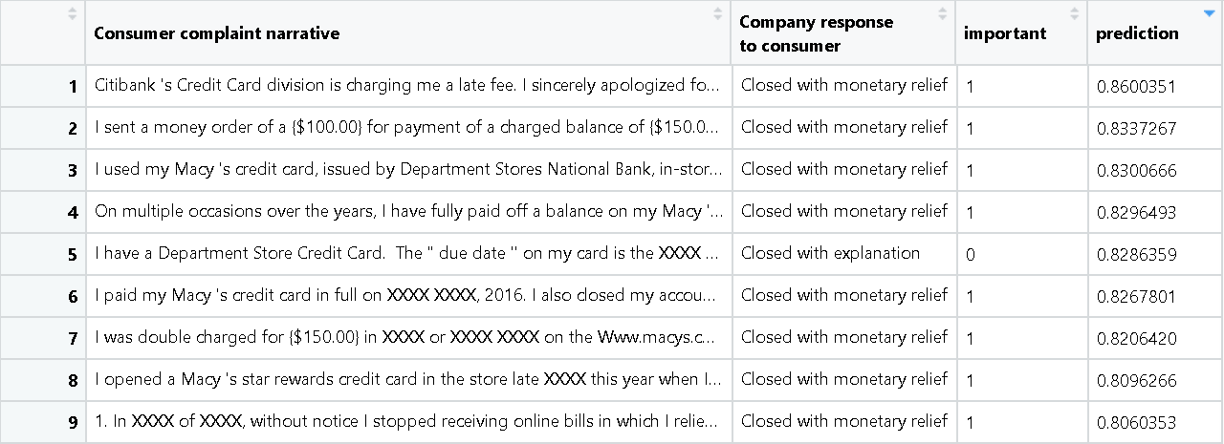
Credit Card

Slide 27
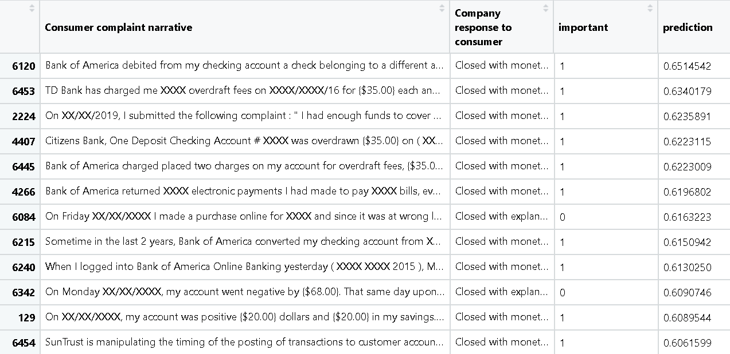
Bank Account

Slide 29
Thank you
Notes:
i will take your word

